Slide 1
Universal Response Engine: LLMs for Good
Team #35
Client: Ahmed Nazar
Advisor: Mohamed Selim

Slide 2
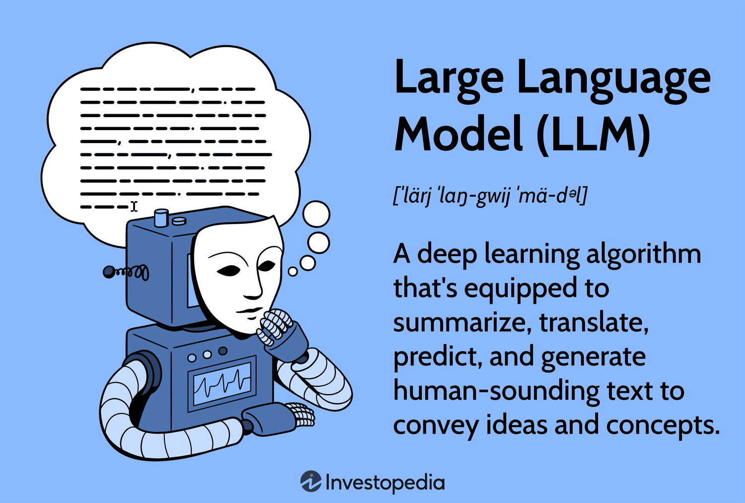
Notes:
What is an LLM?
Go back a few steps…
AI: broad term, intelligent machines
ML: subfield of AI, pattern recognition, predicting data
LLMs: subfield of ML, taking pattern recognition and a combination of other ideas to start generating text, like natural languages, and other data
How do LLMs work?
Combine lots of datasets
Feed data to a neural network that processes it with calculations (like calculating similarity between words)
Finetune it by training it on specific datasets

Slide 3
Project Overview
Creating an LLM for humanitarian use
Chatbot-like website where users provide questions/prompts
Model responds with relevant links, media, info (multimodal)
Notes:
Our project aims to address a critical gap in accessible and comprehensible support for individuals facing challenges. Many people experience difficult circumstances and may feel isolated when seeking help. Although there are a lot of good resources available, they are often fragmented and require these distraught people to sift through multiple pages of information from different sources.
What makes it different: societal good, open-source, no data tracking, to help people in vulnerable situations
Fine-tuned, trained, vetted on empathetic datasets that provide medical advice, emergency advice, etc.

Slide 4
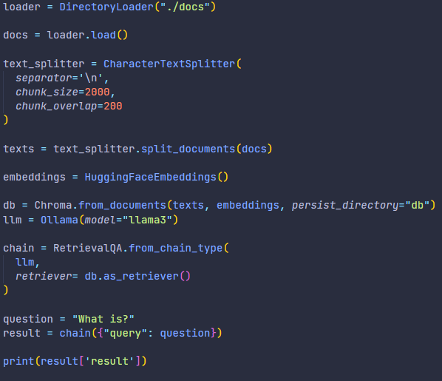
Prototype - RAG (Code Run-Through & Reflect)
The purpose of this prototype is to demonstrate that a retrieval augmented generation (RAG) based LLM can accurately use information from given documents to response to a user’s query.
This fits in our design story because we want our LLM to give accurate information in addition to resources that have more information on the user’s question.
We learned one of the ways to implement a RAG LLM and how it embeds and splits documents we feed it.

Slide 5
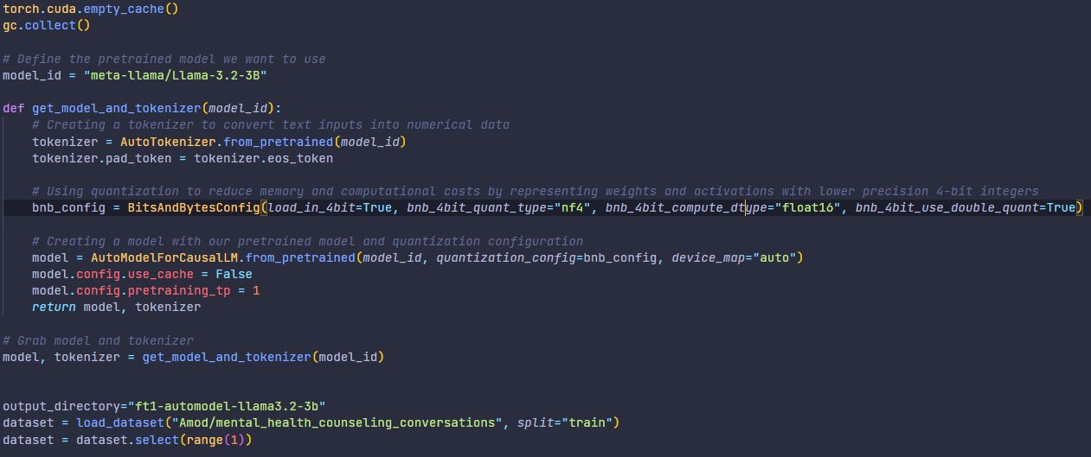
Prototype - Fine-Tuning (Code Run-Through & Reflect)
The purpose of this prototype is to show how this model utilizes version 3.2 3B of Llama and tokenizes it. It also prepares the dataset that will be used for training.
This training will teach the model how to stylize its response to the user based on the dataset we give it.
We are learning how to prepare a model for fine tuning in this prototype.

Slide 6
Prototype - Fine-Tuning (Code Run-Through & Reflect)
The purpose of this prototype is to prepare the data from the dataset to be in the proper format of: instruction, context, and response.
This step provides the LLM with a consistent and clear dataset format to ensure quality training.
We are learning what the desired layout of the data should look like when searching for more datasets, but we also learned how to reformat datasets if the one we want to use is not in the desired format.

Slide 7
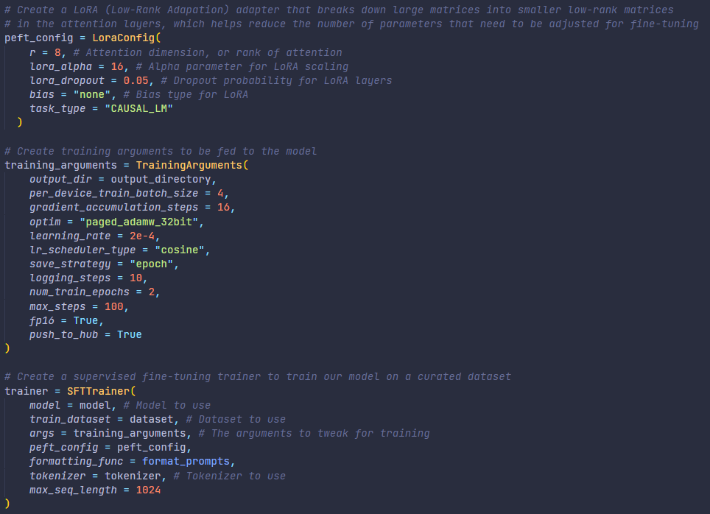
Prototype - Fine-Tuning (Code Run-Through & Reflect)
The purpose of this prototype is to set all the relevant parameters regarding the low rank adaptation (LORA) configuration, training arguments, and the supervised fine tuning (SFT) trainer.
This step is necessary to specify how we want our model to be conducting its training. Things like how many times it should iterate throughout the entire dataset and how much GPU memory will be used gets determined here.
Here, we learn how each argument can change the quality and time taken for our model to complete training.

Slide 8
Prototype - Fine-Tuning (Example Conversation Chain)

Slide 9
Prototype - Frontend (UI)

Slide 10
Prototype - Frontend (UI Demo)
Our frontend is very simple as of right now and is not connected to our model. You can only send messages but not receive anything back yet.

Slide 11
Prototype - Frontend (Reflect)
The purpose of our frontend prototype was to provide a visualization of what our product will look like to our users. Our prospective users are people who are in need and may be in possible distress. We want our user interface to be simple and easy to navigate, as displayed by our prototype.
The prototype we used shows the user who entered a text input “Hello.” The user can input text in the “Type your message…” field and send that message to the LLM by pressing the “Send” button. This message will show up on the screen along with the response from the LLM.
We learned the basics of what we need to provide to our users. The user was able to enter text, send it and have it show up on the screen. We will continue to work on implementing multimodal user input in the future.

Slide 12
Implications and Next Steps
We have made good progress and have a solid foundation for going into next semester.
Next Steps
Connecting the front and back end
Making the front end more accessible and implement multi-modal input
Get more datasets so that we can cover all the topics we want to

